Slide 1


Synthetic data generation and analysis for Blender
Students honour programme
Daniel Jimenez - 1939216
Massimo Perri - 1632744
Data Science master’s programme
La Sapienza University of Rome

Slide 2
introduction
The creation of synthetic dataset is motivated by the fact that on public datasets the don’t contain usable device fingerprints* linked to a device.
The dataset must consider the following characteristics:
The station’s distance must be taken into account, to create paths. Closer stations should be more likely to be part of the same path of a device.
Unhability of a station to produce device fingerprint data. For example, the station doesn’t detect the device it in time and the device goes out of range first.
Not all the stations have the same amount of people passing through along the day.
Patterns in visiting places in each day, week and month. For example, workers have almost the same path during a working week with slightly difference in the time range.
*Device fingerprint: Refers to a unique ID of a device that has a BLE technology (ie, phones).

Slide 3
High level process
Loop until all stations have the desired number of devices
Device Fingerprint and paths generation
Get physical distance from one station to another
Adjust particular cases
Repeat paths morning/afternoon
Repeat path along days
Number of devices per station
Repeat path along weeks
Stations selection
Distance among stations
Generate global number of devices per station
Initial paths for devices
Define simulated geocoded stations
Repeat simulated paths from morning to afternoon
Modify some cases to reflect the reality more accurately
Repeat paths simulated for each day
Generate paths for each device
Repeat paths simulated for each week
1
2
3
4
5
6
7
8
Notes:
In order to perform this task we mainly followed a model named FamNet which is depicted here. The idea behind this model is to use the last few feature maps of a pretrained ImageNet model from which we will extract the information from each of the example boxes and then use these boxes as kernels to apply a 2d convolution on the feature map image itself. This output is then concatenated with that of all the boxes and of all the feature maps we provide to the FamNet model. The output will then be a tensor of 4 dimensions which will be fed into a multilayer convolutional network which outputs a 2d density map. The predicted number of objects will be obtained from this final density matrix.
The main thing to understand from all of this is that the model is weakly dependent on the size of the feature maps we provide it with and that it is completely independent of the number of example boxes used.

Slide 4
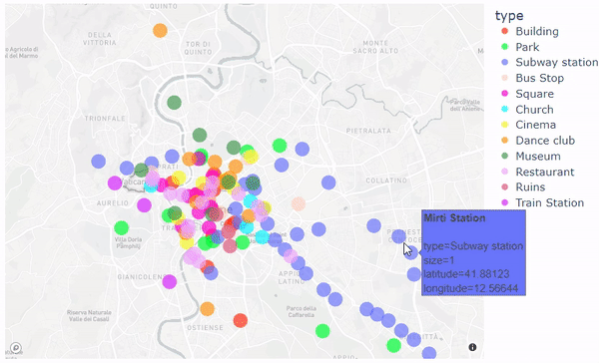
1. Stations selection
Select 130 representative places (so-called stations) from Rome.
Places are of type: Building, Church, Cinema, Dance club, Museum, Park, Restaurant, Ruins, Square, Subway station, Train Station, Bus Stop
Get addresses using Google Maps (manually).
Geocode (get latitude, longitude) using geopy in Python. Exec. time: 1.5 minutes
Provide weights (expected proportion of people) to each stations (expert-wise assigned).

Slide 5
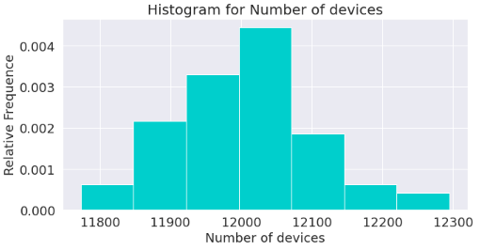
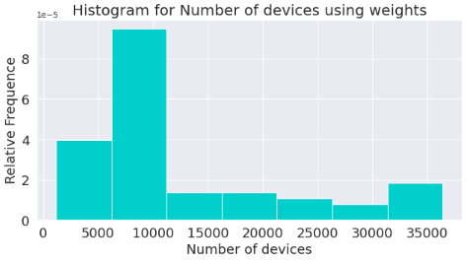
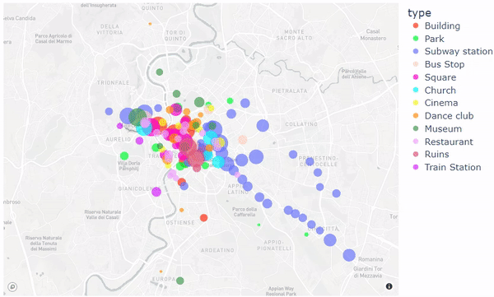
2. Number of devices per station
Randomly create number of devices per station.
Use a Poisson distro. with mean = 12,000 devices per month.
Multiply the previous variable by the weights to simulate a real-type distribution of the devices.
The diameter of the circles represents the number of devices.

Slide 6
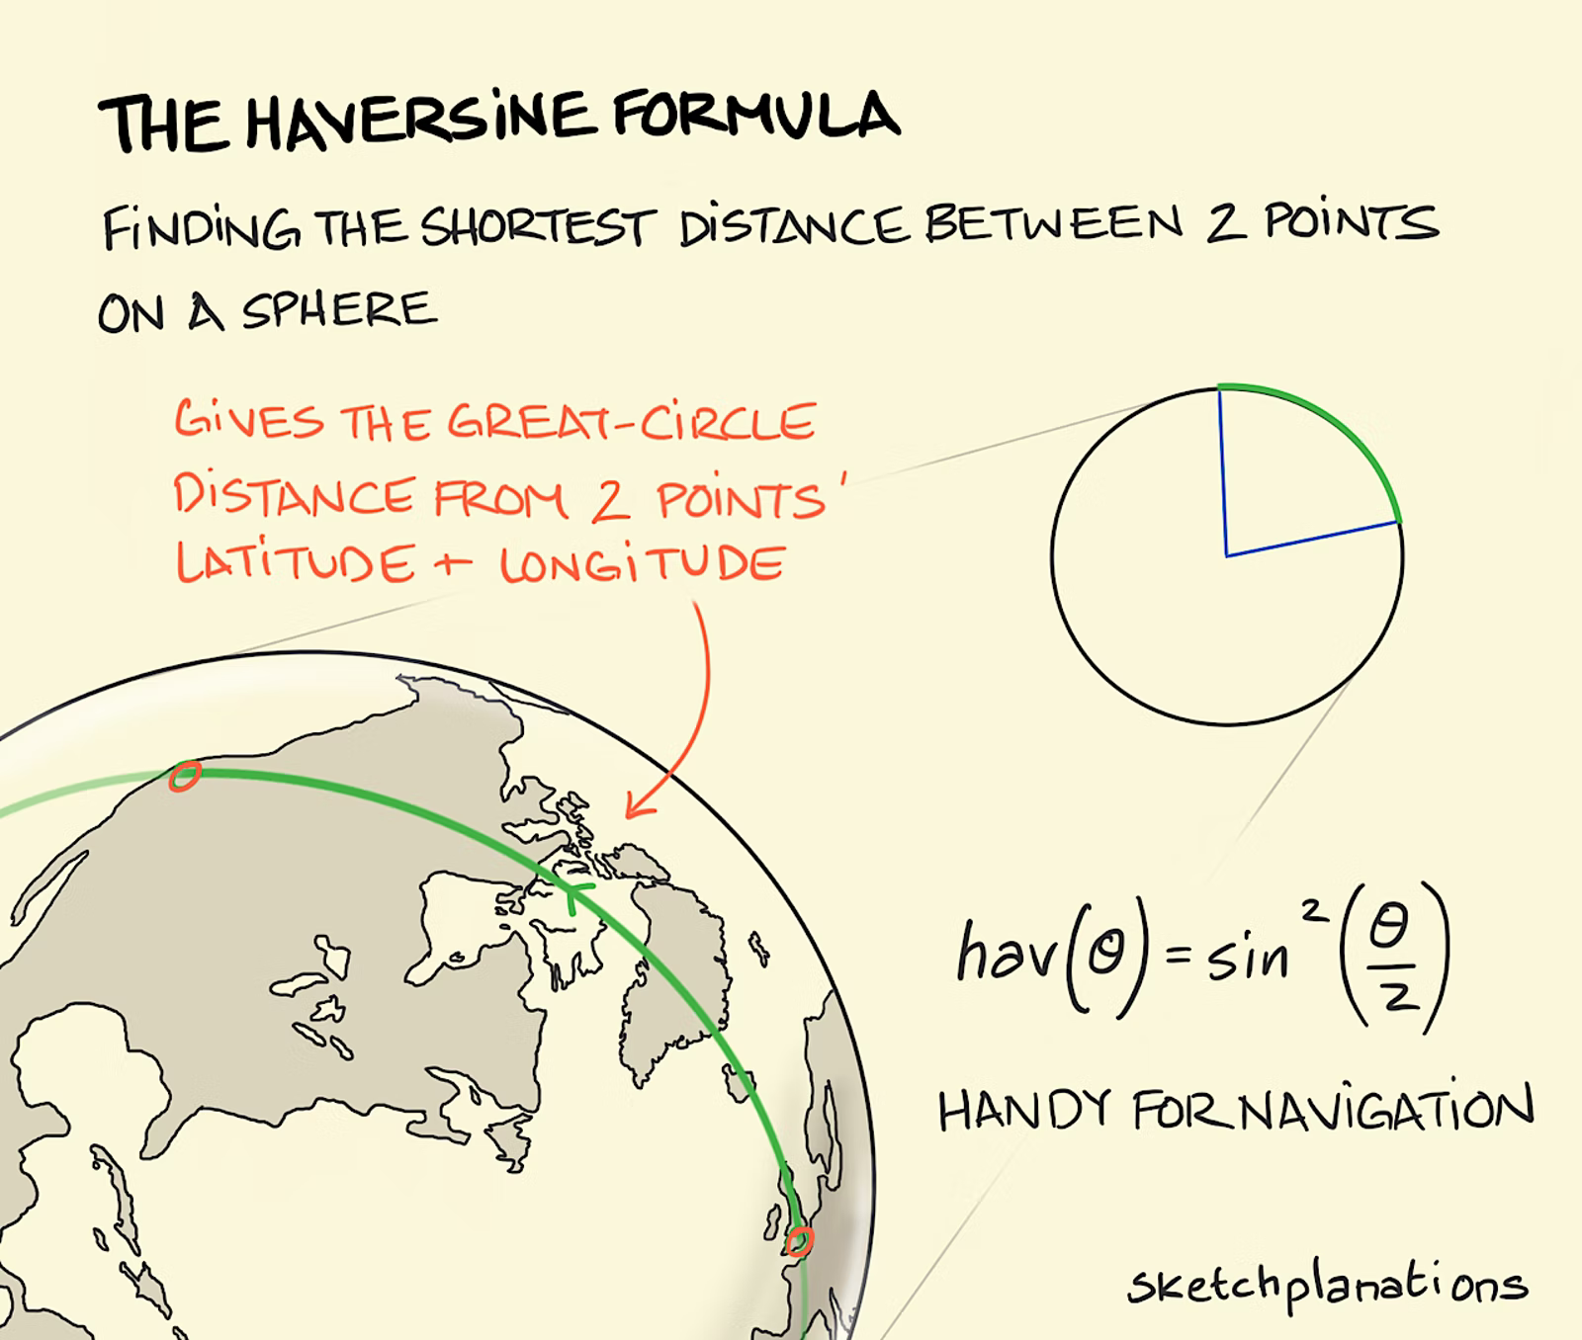
3. Distances among stations
Use latitude and longitude to calculate distance in kilometers (km) from one station to another.
For the calculation the Haversine distance was applied.
The calculation took 2.3 seconds to run for all the stations.

Slide 7
4. Initial paths for devices
Initial point & stations visited
Hour and date definition
receiving time calculation
Randomly select one station defining the device fingerprint linked to that station (initial point).
Randomly define number of stations to be visited per device (length of the path). Using Poisson distro. with mean of 10 stations per device in a month.
Randomly sample stations depending on their closeness to the initial point using Probability-proportional-to-size (PPS).
Randomly remove some stations to simulate connection delays or timeout (non-produced fingerprint) .
Randomly simulate hour of the signal’s reception. Using a Gamma distribution with shape = 10 and mean depending on the type of place.
Define minimum and maximum possible date. It was set to one month (01-31 of March 2022).
Proportionally random sample one day from dates’ range, wrt to type of place and day of the week (get more data from work days than weekends).
Random generation of speed of the person (device’s owner). Gamma distro. with shape=0.4 and mean 5 km/h.
Calculate the time in minutes from one station to another using: time= distance / speed.
Calculate the signal’s receiving time in each station of the path.

Slide 8
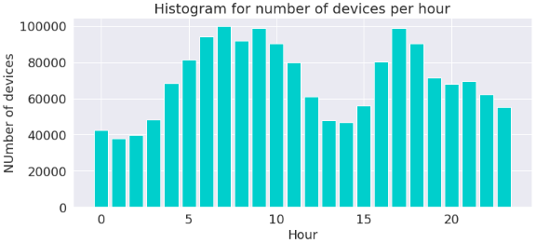
5. Repeat paths morning/afternoon
Define randomly if the path should be repeated. Using Bernoulli distro. with p = 0.6*.
Randomly define the difference of time between initial path and desired repetition in the afternoon.
Give more probability to differences of 9 hours, later to those of 10 or 8, afterwards to 11 or 7 and so on.
Add (or subtract) minutes from the previous hour in a uniform range between -10 and 10.
Reverse the calculated hours and minutes to simulate when workers are returning from their job.
Concentration of devices occurring at rush hours (7-9 am and 4-6 pm)
*Employment rate in Lazio region taken from: https://www.statista.com/statistics/586962/employment-rate-by-region-italy/
Notes:
Half past seven until 9 from 4 pm to six pm
1

Slide 9
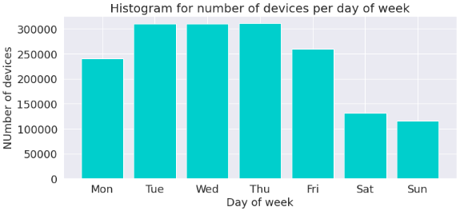
6. Repeat path along days of the week
Define randomly if the path should be repeated. Using Bernoulli distro. with p = 0.6*.
Repeat the same path along the whole week (from Monday to Friday).
Add (or subtract) minutes from the previous hour in a uniform range between -10 and 10.
Keep only dates defined inside of possible dates (01-31 of March 2022).
Concentration of work days is almost constant. Concentration of weekends less than work days.
*Employment rate in Lazio taken from: https://www.statista.com/statistics/586962/employment-rate-by-region-italy/

Slide 10
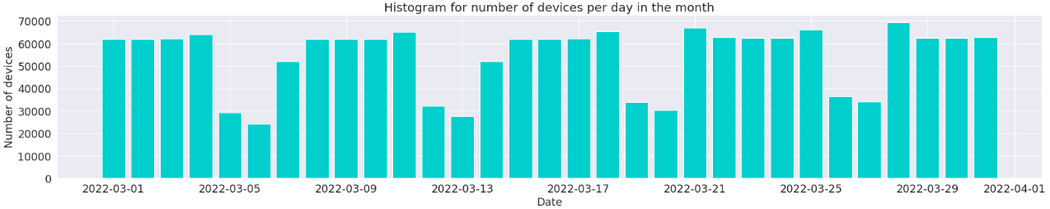
7. Repeat path along weeks of the month
Define randomly if the path should be repeated. Using Bernoulli distro. with p = 0.6*.
Repeat the same path along the whole month (in every week).
Add (or subtract) minutes from the previous hour in a uniform range between -10 and 10.
Keep only dates defined inside of possible dates (01-31 of March 2022).
Week 1
Week 2
Week 3
Week 4
Week 5
Tuesday
Thursday
*Employment rate in Lazio taken from: https://www.statista.com/statistics/586962/employment-rate-by-region-italy/

Slide 11
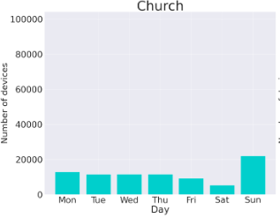
8. Adjust particular cases
aDD MORE DEVICES FOR cHURCHES ON SUNDAYS
Define randomly if the current device at the station should be modified. Using Bernoulli distro. with p = 0.33.
Offset the date of selected devices to the next Sunday.
Depopulate only devices from Tuesdays, Wednesdays and Thursdays.
Keep only dates defined inside of possible dates (01-31 of March 2022).
Concentration of devices in Churches occurring more often on Sundays.

Slide 12
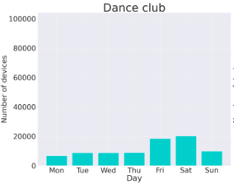
8. Adjust particular cases
aDD MORE DEVICES FOR Dance clubs ON friday, saturday, SUNDAY
Define randomly if the current device at the station should be modified. Using Bernoulli distro. with p = 0.5.
Offset the date of selected devices to the next Friday, Saturday or Sunday.
Depopulate only devices from Mondays, Tuesdays,, Wednesdays and Thursdays.
Keep only dates defined inside of possible dates (01-31 of March 2022).
Concentration of devices in Dance clubs occurring more often on Friday and Saturdays than on Sundays.

Slide 13
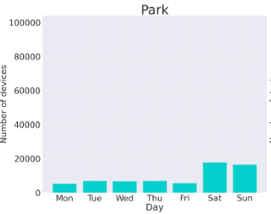
8. Adjust particular cases
aDD MORE DEVICES FOR parks ON saturdays and sundays
Define randomly if the current device at the station should be modified. Using Bernoulli distro. with p = 0.5.
Offset the date of selected devices to the next Saturday or Sunday.
Depopulate only devices from Mondays, Tuesdays,, Wednesdays, Thursdays and Fridays.
Keep only dates defined inside of possible dates (01-31 of March 2022).
Concentration of devices in Parks occurring more often on Saturdays and Sundays.

Slide 14
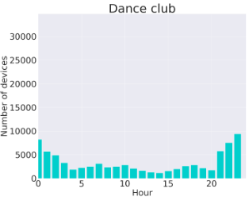
8. Adjust particular cases
more attending hours at night FOR dance clubs
Define randomly if the current device at the station should be modified. Using Bernoulli distro. with p = 0.25.
Offset the date of selected devices to the nocturnal hours. It occurs more likely at 00: and 23:00. Later at 01:00 and 22;00. Finally at 02:00 and 21:00.
Depopulate only devices from with hours between 03:00 and 22:00.
Keep only dates defined inside of possible dates (01-31 of March 2022).
Concentration of devices in Dance club occurring at night.

Slide 15
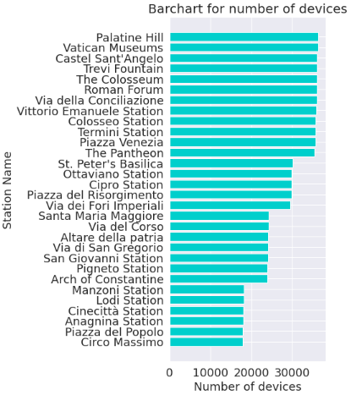
Generalities of the synthetical dataset
Summary of dataset
Stations with most devices (top 30)
Number of stations: 130
Number of distinct devices fingerprints: 26,832
Number of total devices in stations: 1’679,411
The execution time for the process is close to 2.5 hours.
To define the total number of devices we took into account that:
Each station produce 282 MB/month.
One dataset with 10 columns and 10,000 rows has a size of 1.63 MB.
1’679,411

Slide 16
Prediction of devices per station
Goal: Predict the number of devices for unseen stations at any particular position, day and hour in March 2022.
Station’s features:
Type of station (Restaurant, Church, Subway station, etc.)
Latitude and 'longitude
Day of the moth (1st to 31st March)
Hour of the day (00:00 to 23:00)
Week of the month (1st-5th week)
Day of the week (Monday to Sunday)
Models used:
XG-Boost (one of best regression frameworks)
Catboost (innovative and introduced by Yandex in 2017)
Random Forest (classic technique)

Slide 17
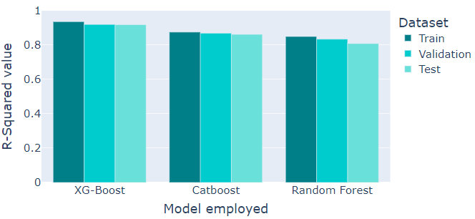
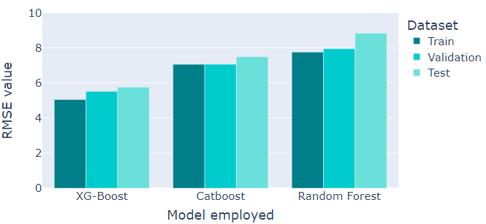
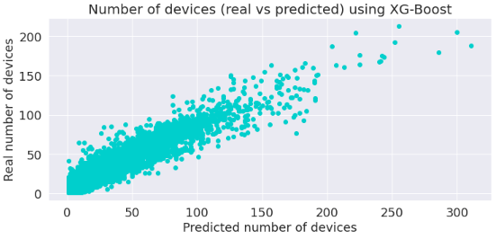
Model’s Performance
R-Squared comparison
RMSE comparison
Fine tuning of the models done with CV Random search.
Best R-Squared around 92% and best RMSE close to 5.2 for XG-Boost.

Slide 18
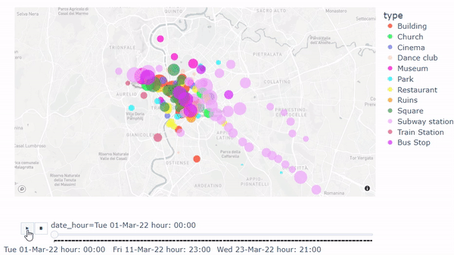
Map of Predictions
Hourly-Predicted number of devices along March
The diameter of the circles represents the number of devices.
The prediction was done by day and hour.

Slide 19
Thank you

